Slide 1
1
Skin Detection using KNN
Group 11

Slide 2
1
Methodology Steps
1. Dataset Preparation for one image
Supervised learning / Using Kneighbors Classifier-Predict Training X
- Score performance using (x,y)
Fit the model
Read the training and predict the image
Change steps so it can predict more images

Slide 3

1
Methodology Steps…Data Preparation
1. STEP I
Read the Original image data
Resize the image (scale= 5)
Get the data of the original image (r,g,b) pixel dataset and list all pixel data
Save the pixel data into csv file
2. STEP II
Compute the above steps for the skin mask

Slide 4
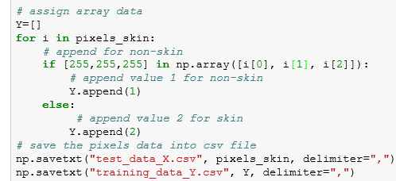
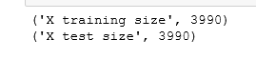
1
Methodology Steps…Data Preparation
3. STEP III
With each pixel if RGB value is 255 255 255 we append 1 as non skin else we append 2 for skin
And we save the test data X and training data Y cvs
Read ,training data and test data, check len is equal

Slide 5
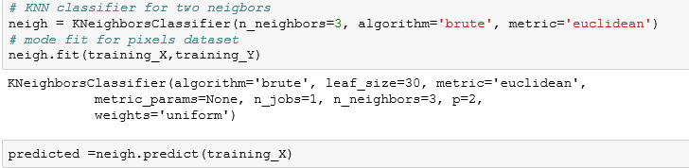
1
Methodology Steps…
4. STEP IV
Kneighbors Classifier for three neighbors, algorithm = brute, metric = Euclidean
Fit the model
Predict (training _X)
Compute score using (training_X, and training _Y) i.e RGB value and 1,2)

Slide 6
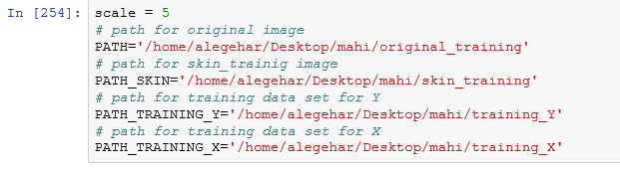
1
5. STEP V – Multiple image
Create paths, for original image, skin_training image, traing dataset for Y and training dataset for X.
List all image in original test directory and store as an array
Read image from the list and resize

Slide 7
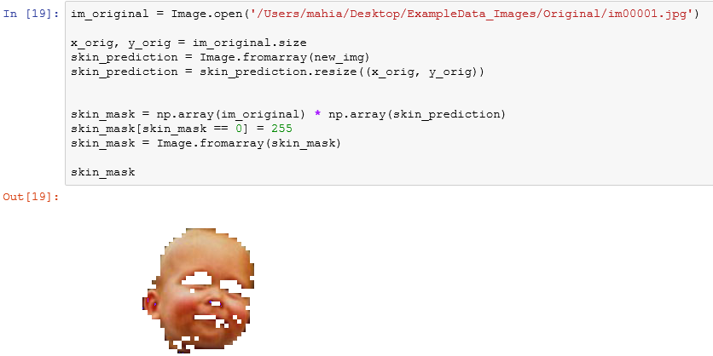
1
RESULT
Predicted image output step

Slide 8
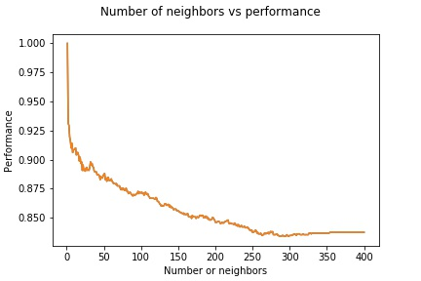
Accuracy and Performance
K= Number of neighbors
In training 1500 img , K=400 When K = 325, Performance= 83.5%
When K=354, Performance= 83.7%
When K=400, Performance= 83.7%
Time for Processing 400 neighbors 30.8957219124 sec
Thus ,the best performance we got for the training set K= 325

Slide 9
1
Thank YOU !

